Slide 1


Weekly Report NTUA 28/2/2020
George Bakas

Slide 2
Status Report
Analysis:
TMG Meeting
Inconsistencies between Mtt files and Nominal files--> 2017 and 2018
Especially the Mtt 700-1000 file
Mass fit
NTUA HEP Site
Modifications
http://modio.physics.ntua.gr/~gbakas/HEP-NTUA-CMS-Online/
HEP Data for TOP-18-013
Class ready for importing tables (histograms) using ROOT file

Slide 3
Control Region Shape Comparison

Slide 4
Control Region Shape Comparison

Slide 5
Control Region Shape Comparison

Slide 6
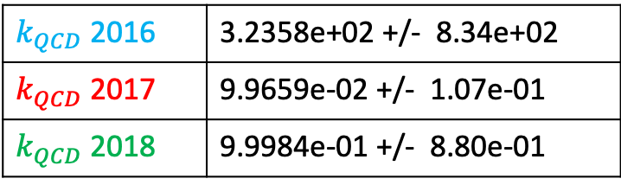
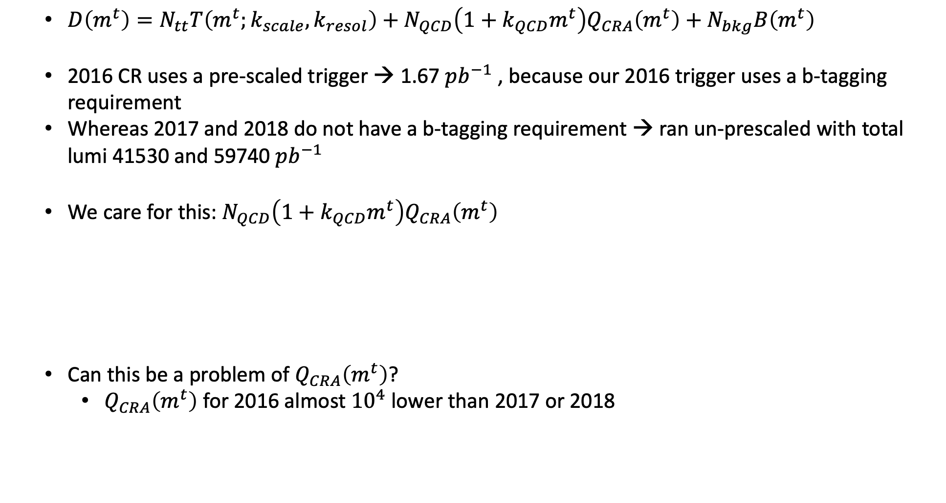
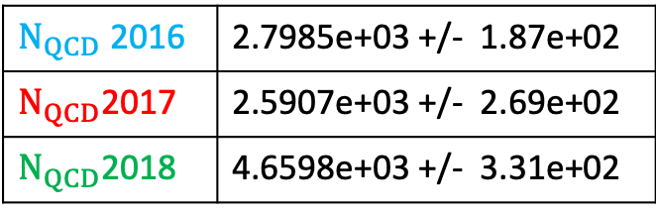
Mass Fit
$D\left(m^{t}\right)=N_{tt}T\left(m^{t};k_{scale}, k_{resol}\right)+N_{QCD}\left(1+k_{QCD}m^{t}\right)Q_{CRA}\left(m^{t}\right)+N_{bkg}B\left(m^{t}\right)$
2016 CR uses a pre-scaled trigger → 1.67 $pb^{−1}$ , because our 2016 trigger uses a b-tagging requirement
Whereas 2017 and 2018 do not have a b-tagging requirement → ran un-prescaled with total lumi 41530 and 59740 $pb^{−1}$
We care for this: $N_{QCD}\left(1+k_{QCD}m^{t}\right)Q_{CRA}\left(m^{t}\right)$
Can this be a problem of $Q_{CRA}\left(m^{t}\right)$?
$Q_{CRA}\left(m^{t}\right)$ for 2016 almost ${10}^{4}$ lower than 2017 or 2018
$k_{QCD}$ 2016 | 3.2358e+02 +/- 8.34e+02
$k_{QCD}$ 2017 | 9.9659e-02 +/- 1.07e-01
$k_{QCD}$ 2018 | 9.9984e-01 +/- 8.80e-01
$Ν_{QCD}$ 2016 | 2.7985e+03 +/- 1.87e+02
$Ν_{QCD}$2017 | 2.5907e+03 +/- 2.69e+02
$Ν_{QCD}$2018 | 4.6598e+03 +/- 3.31e+02

Slide 7
Response matrix comparison Mtt vs Nominal

Slide 8
Response matrix comparison Mtt vs Nominal

Slide 9
Response matrix comparison Mtt vs Nominal

Slide 10
Response matrix comparison Mtt vs Nominal

Slide 11
Response matrix comparison Mtt vs Nominal

Slide 12
Response matrix comparison Mtt vs Nominal

Slide 13
BACKUP

Slide 14
Control Region Shape Comparison

